Slide 1
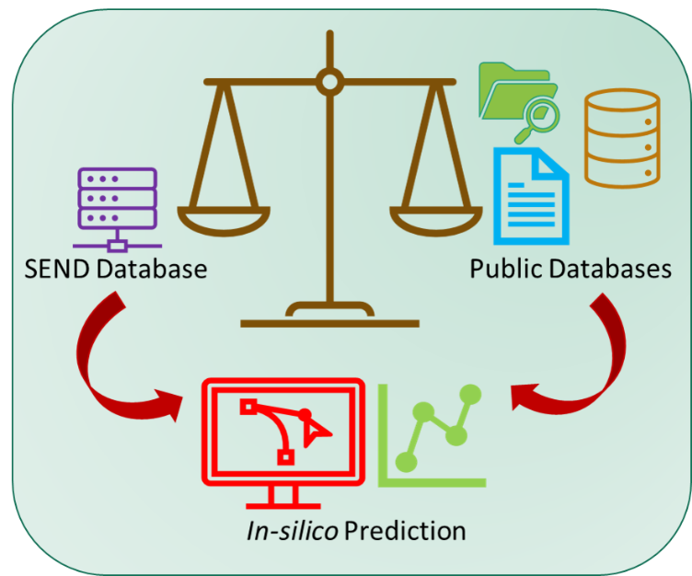
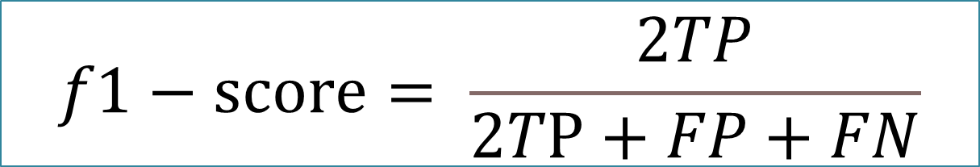
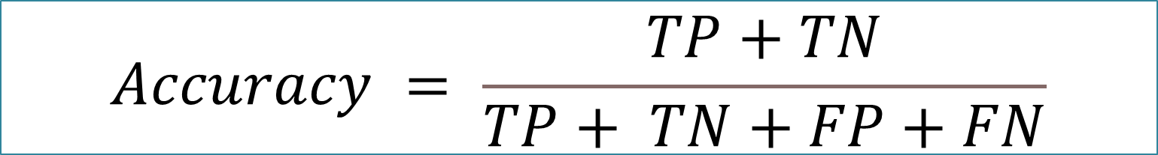

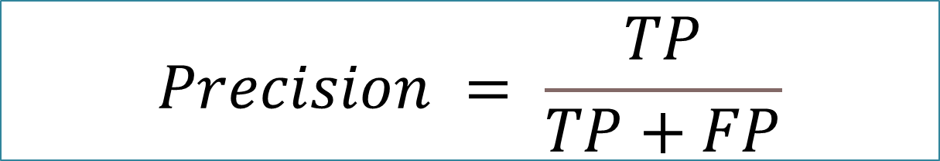
In Silico Toxicity Assessment by QSAR MODELING: Bridging the Knowledge Gap Using Standardized Electronic Submission Data
Md Aminul Islam Prodhan^{1,2}, C M Sabbir Ahmed¹, Snyder Kevin¹
¹U.S. Food and Drug Administration (FDA), Silver Spring, MD; ²Oak Ridge Institute for Science and Education, Oak Ridge, TN.
BACKGROUND
MODEL PERFORMANCE EVALUATION
Quantitative structure-activity relationship (QSAR) based approaches have proven to be very valuable in predicting toxicity. QSAR approaches can be a helpful tools within regulatory decision-making process for toxicity screening of chemicals in a nonclinical toxicology studies. In this work we used QSAR model for exploring the relationship between the toxicity study endpoint i.e., body weight contained in the SEND dataset and the corresponding chemical features ( structural information) of the drug under investigation. We employed the cheminformatics and machine learning approaches to predict the toxicity.
# 1-2 lines about the body weight and its significance
$$Precision = \frac{TP}{TP+FP}$$
$$Recall = \frac{TP}{TP+FN}$$
$$f1−score= \frac{2TP}{2TP+FP+FN}$$
$$Accuracy = \frac{TP+TN}{TP+ TN+FP+FN}$$
Four metrics (precision, recall, f1-score, and accuracy) were used to assess model performance as mentioned by the above equations where TP, FP, TN, and FN represent the respective counts for the true positive, false positive, true negative, and false negative cases.
RESULTS
From the SEND After following the data analysis , 576 unique compounds were found. The resulting classifiers showed acceptable overall accuracy (balanced accuracy, 57-66%) through a ten-fold cross validation process for each liver disease phenotype. In the future, this workflow could be amended and improved with the submission and incorporation of new SEND data, as well as be extend to other complex toxicity endpoints (e.g., nephrotoxicity, cardiotoxicity) to inform on potential novel biological processes and perturbations.
The models showed balanced accuracy from 58 to 66% with a universally lower recall (37-41%) than precision (63 – 82%)
Figure 1. Schematic of QSAR model building
DATA PREPARATION
QSAR MODEL BUILDING (CONTINUING)
BODY WEIGHT Z-SCORE CALCULATION
Animal body weight z-score data and the corresponding calculated molecular descriptor were used to train machine learning models (Classification) to predict the probability of toxicity. Body weight z-score data were classified into toxic, mild-toxic, and non-toxic based on a defined threshold. In another scheme, z-score ≤ -2 , -2 ≤ z-score ≤ -1 , and z-score ≥ -1 were classed as toxic, mild-toxic and non-toxic, respectively. In another scheme, AB z-score ≤ ‘- 2’ and z-score ≥ -2 were classed as toxic and non-toxic, respectively
The AB data are spitted in training data and test data (ratio3:1). We also did 10-fold-cross validation for the model validation. In addition, We also applied the feature selection technique to select the important feature which has the strong relationship with the toxicity and the predictor. We employed 12 classification machine learning technique including Random forest classifier, Gradient Boosting Classifier, AdaBoost Classifier, CatBoost Classifier etc.
Additon, of Species and SEX as a predictor ……….. Without species and sex.
Select the dog, rat and other species as well.. All species .
Negative Control animal body wight (NC) data & animal Body wight (AB) from the SEND database were extracted by SQL Query. In each study, data representing the maximum dose were extracted from the AB data. Finally, NC and high dose AB data were used for Body Weight Z-Score calculation.
CONCLUSIONS
In this work, machine learning methods to leverage the wealth of toxicity study data contained with SEND data
submitted to the U.S. FDA. In this initial attempt of large-scale cross-study analysis applying these techniques, we characterize rat hepatotoxicity
MOLECULAR DESCRIPTOR CALCULATION
FUTURE DIRECTION
Body weight base model is performing poorly for toxicity prediction. Some other end points i.e., clinical chemistry results plus body weight data can be used to build the model. In addition, incorporation of structural alert data can also improve the model. We are also working to create a generalized model, where compounds which are toxic as found in public database will be used to build and the model and predict the toxicity of the compounds from the SEND dataset.
Python version 3.9.12, scikit-learn, SQLite3 and R version 4.3.1 was used for implementing data analysis and various machine learning algorithms. Mordred a python-based descriptor calculator package were used for molecular descriptor calculation. We used SMILES molecular notation for descriptor calculation. SEND databased dons not have SMILES information. SMILES information were retrieved from the GSRS dataset in combination with the SESND dataset based on IND number. Mordred is a python-based software which can calculate more than 1800 two- and three-dimensional descriptors.
ACKNOWLEDGEMENT
his project was supported in part by an appointment to the Research Fellowship Program at the Immediate Office/OND/CDER, U.S. Food and Drug Administration, administered by the Oak Ridge Institute for Science and Education through an interagency agreement between the U.S. Department of Energy and FDA..

Slide 2
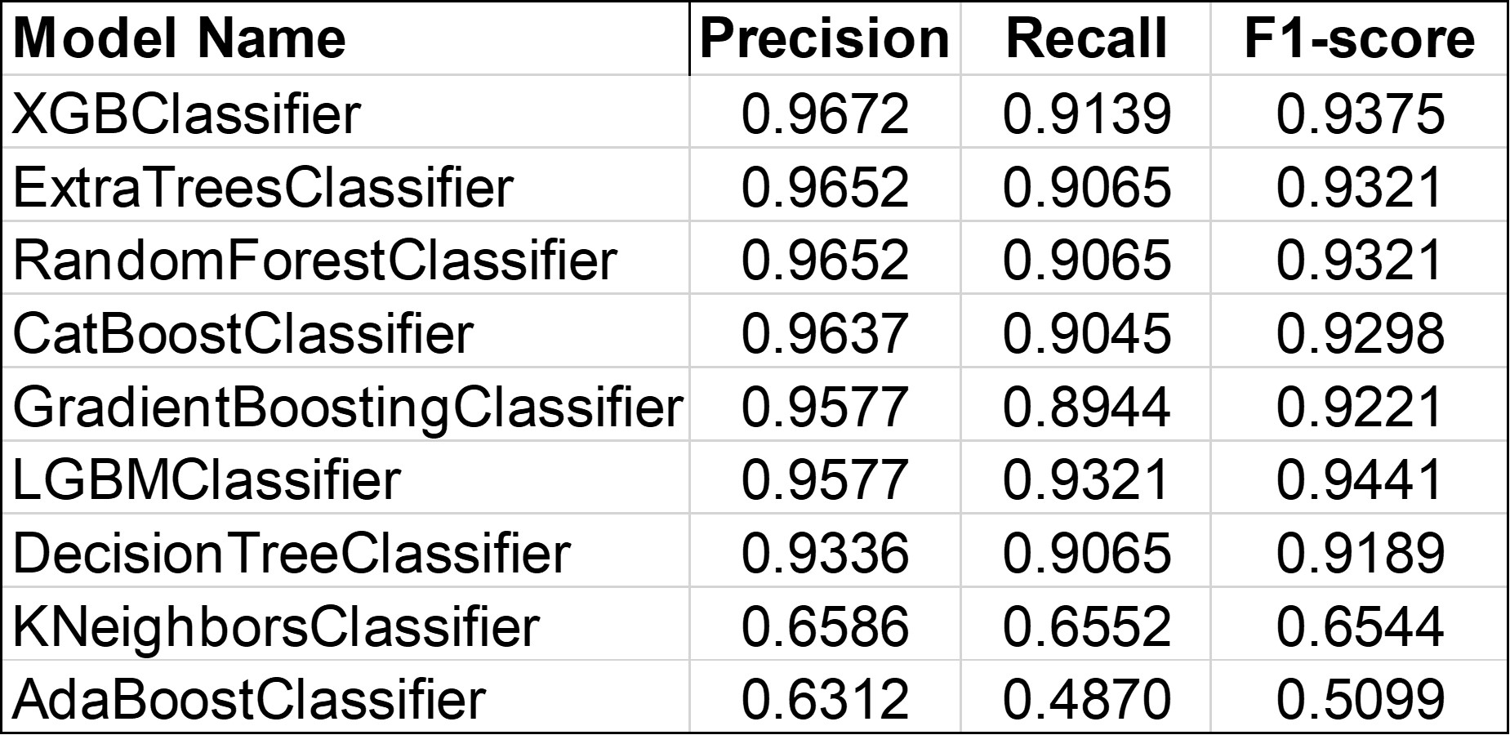
In Silico Toxicity Assessment by QSAR Model: Bridging the Knowledge Gap Using Standardized Electronic Submission Data
Md Aminul Islam Prodhan^{1,2}, C M Sabbir Ahmed¹, Kevin Snyder¹
¹U.S. Food and Drug Administration (FDA), Silver Spring, MD; ²Oak Ridge Institute for Science and Education, Oak Ridge, TN.
BACKGROUND
MODEL PERFORMANCE EVALUATION
Quantitative structure-activity relationship (QSAR) based approaches have proven to be very valuable in predicting toxicity. QSAR approaches can be a helpful tools within regulatory decision-making process for toxicity screening of chemicals in a nonclinical toxicology studies. In this work we used QSAR model for exploring the relationship between the toxicity study endpoint i.e., body weight contained in the SEND dataset and the corresponding chemical features ( structural information) of the drug under investigation. We employed the cheminformatics and machine learning approaches to predict the toxicity.
# 1-2 lines about the body weight and its significance
# should we add little description about send database like species, sex etc.
Four metrics (precision, recall, f1-score, and accuracy) were used to assess model performance as described by the traditional equations containing the true positive, false positive, true negative, and false negative cases. The developed model were then validated by k-fold cross validation.
RESULTS
The data analysis provided 2030 unique rows of 576 unique compounds. The unique rows were based on the compounds, species and sex value. The resulting classifiers showed acceptable overall accuracy (balanced accuracy, average 80%) with other metrics as described in Table 1..
The testing data set also showed a good accuracy of around 50%. While the model metrics looks excellent, but the model showed poor performance in prediction.
Table 1. Machine learning performance metrics
Figure 1. Schematic of QSAR modeling
The models showed balanced accuracy from 58 to 66% with a universally lower recall (37-41%) than
precision (63 – 82%) ; Write about the prediction results as well.
DATA PREPARATION
QSAR MODEL BUILDING (CONTINUING)
BODY WEIGHT Z-SCORE CALCULATION
Animal body weight z-score data and the corresponding calculated molecular descriptor were used to build the machine learning classifier and to predict the probability of toxicity. Body weight z-score (numerical data) data were classified into toxic, mild-toxic, and non-toxic based on a defined threshold value. z-score ≤ -2 , -2 ≤ z-score ≤ -1 , and z-score ≥ -1 were classed as toxic, mild-toxic and non-toxic, respectively. In another scheme, z-score ≤ - 2 and z-score ≥ -2 were classed as toxic and non-toxic, respectively
The AB data are spitted in training data (80%) and test data (20%) . We also did 10-fold-cross validation for the model validation. In addition, We also applied the feature selection technique to select the important feature which has the strong relationship with the toxicity and the predictor. We employed 12 classification machine learning technique including Random forest classifier, Gradient Boosting Classifier, AdaBoost Classifier, CatBoost Classifier etc. In addition to chemical descriptor, species and SEX of the animal were also used as a features by converting them in numerical values by encoding technique. We also built the model by selecting the unique species and sex values.
Negative Control animal body wight (NC) data & animal Body wight (AB) from the SEND database were extracted by SQL Query from Body wight (BM) domain. In each study, data representing the maximum dose were extracted from the AB data. Finally, NC and high dose AB data were used for Body Weight z-score calculation where z-score was calculated each (animal body weight – means body weight of control group)/ standard deviation of control animal in each study
DISCUSSIONS
In this work, machine learning methods were used to QSAR study employing toxicity study data contained with SEND data submitted to the U.S. FDA. In the future, this workflow could be amended and improved with the submission and incorporation of new SEND data, as well as be extend to other toxicity endpoints
MOLECULAR DESCRIPTOR CALCULATION
FUTURE DIRECTION
Body weight base model is performing poorly for toxicity prediction. Some other end points i.e., clinical chemistry results plus body weight data can be used to build the model. In addition, incorporation of structural alert data can also improve the model. We are also working to create a generalized model, where compounds which are toxic as found in public database will be used to build and the model and predict the toxicity of the compounds from the SEND dataset.
Python version 3.9.12, scikit-learn, SQLite3 and R version 4.3.1 was used for data analysis and implementing various machine learning algorithms. Mordred a python-based descriptor calculator package were used for molecular descriptor calculation. Mordred is a python-based software which can calculate more than 1800 two- and three-dimensional descriptors. We used SMILES molecular notation for descriptor calculation. SEND databased dons not have SMILES information. SMILES information were retrieved from the GSRS dataset in combination with the SESND dataset based on IND number. Among the calculated descriptor, finally 194 descriptor were used for the machine leaning classifier model building.
ACKNOWLEDGEMENT
his project was supported in part by an appointment to the Research Fellowship Program at the Immediate Office/OND/CDER, U.S. Food and Drug Administration, administered by the Oak Ridge Institute for Science and Education through an interagency agreement between the U.S. Department of Energy and FDA..

Slide 4
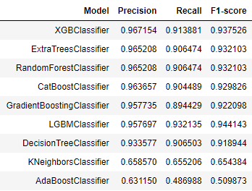
circular_kevin_w_comn_smilie_added_in_mdf_All_Species_tnm_M_F
Precision Recall F1-score Confusion Matrix
XGBClassifier 0.967154 0.913881 0.937526
ExtraTreesClassifier 0.965208 0.906474 0.932103
RandomForestClassifier 0.965208 0.906474 0.932103
CatBoostClassifier 0.963657 0.904489 0.929826
GradientBoostingClassifier 0.957735 0.894429 0.922098
LGBMClassifier 0.957697 0.932135 0.944143
DecisionTreeClassifier 0.933577 0.906503 0.918944
KNeighborsClassifier 0.65857 0.655206 0.654384
AdaBoostClassifier 0.63115 0.486988 0.509873
Precision | Recall | F1-score | Confusion Matrix
XGBClassifier | 0.967154 | 0.913881 | 0.937526
ExtraTreesClassifier | 0.965208 | 0.906474 | 0.932103
RandomForestClassifier | 0.965208 | 0.906474 | 0.932103
CatBoostClassifier | 0.963657 | 0.904489 | 0.929826
GradientBoostingClassifier | 0.957735 | 0.894429 | 0.922098
LGBMClassifier | 0.957697 | 0.932135 | 0.944143
DecisionTreeClassifier | 0.933577 | 0.906503 | 0.918944
KNeighborsClassifier | 0.65857 | 0.655206 | 0.654384
AdaBoostClassifier | 0.63115 | 0.486988 | 0.509873

